Slide 1
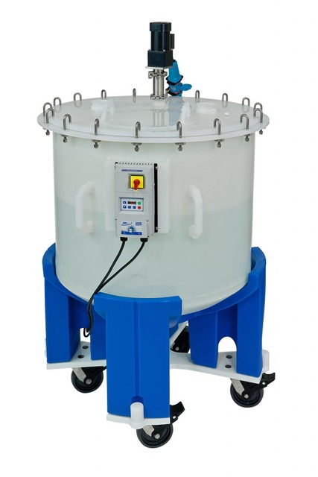
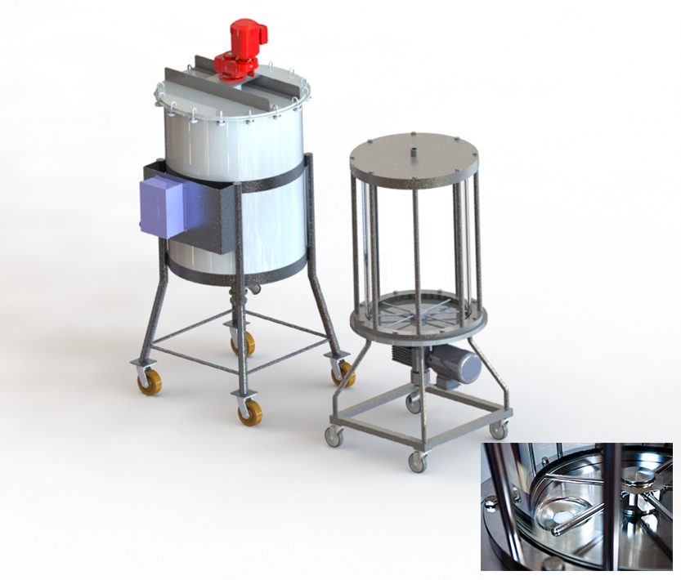
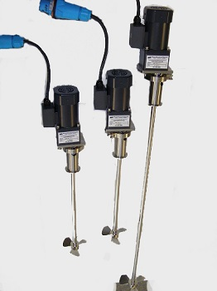
White Mountain Process & Life Science Solutions
SANITARY + BIOPHARMA PROCESS EQUIPMENT – built to your exact specifications!

Slide 2
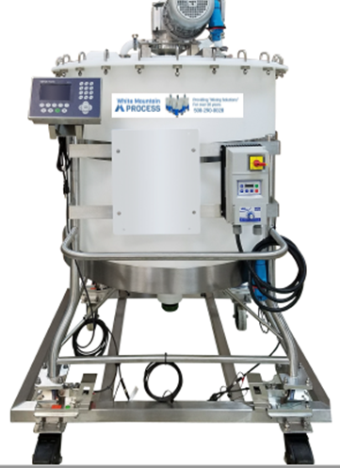
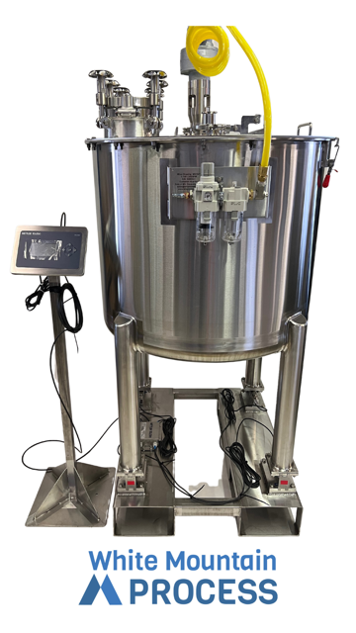
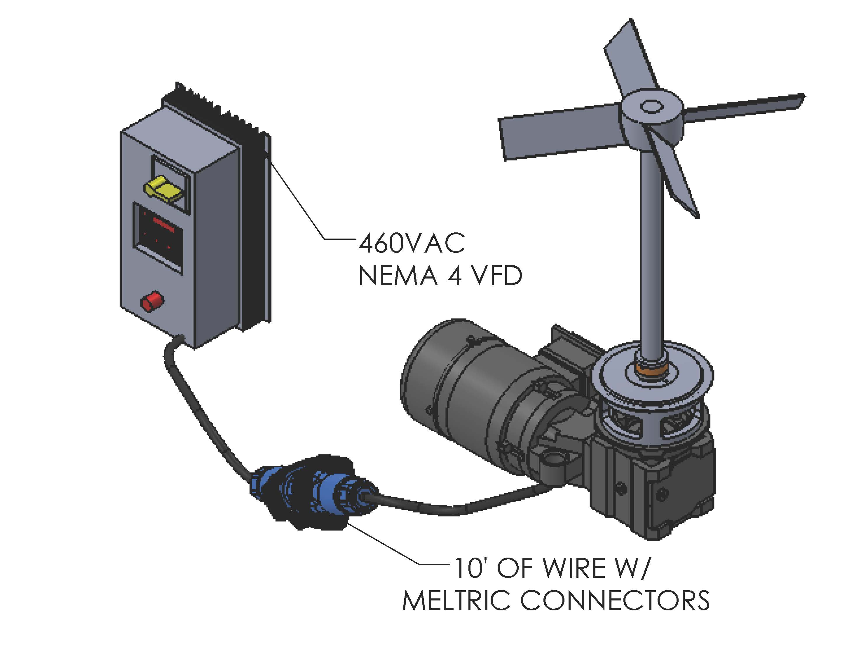
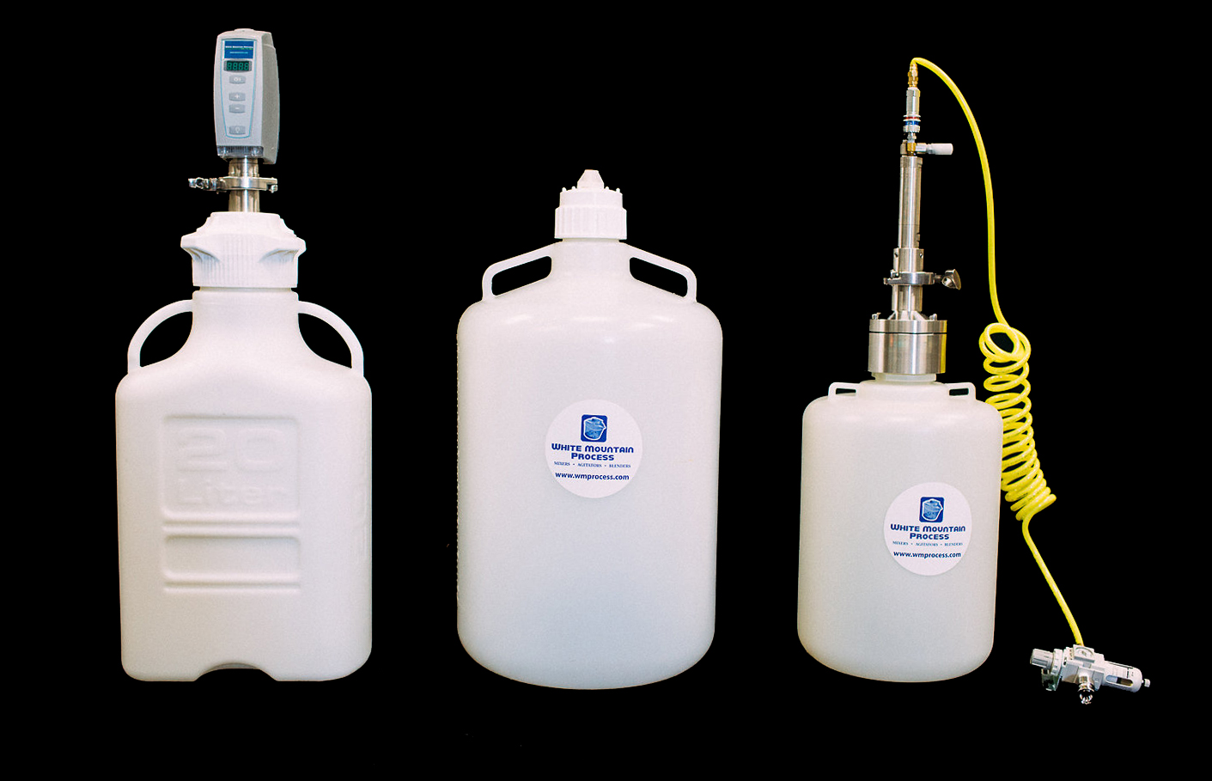
Mixer + Agitator Expertise Blending Systems
Top/Bottom Entry Mixers
Carboy Mixing Systems
Poly Mixing Tanks
Stainless Mixing Tanks

Slide 3
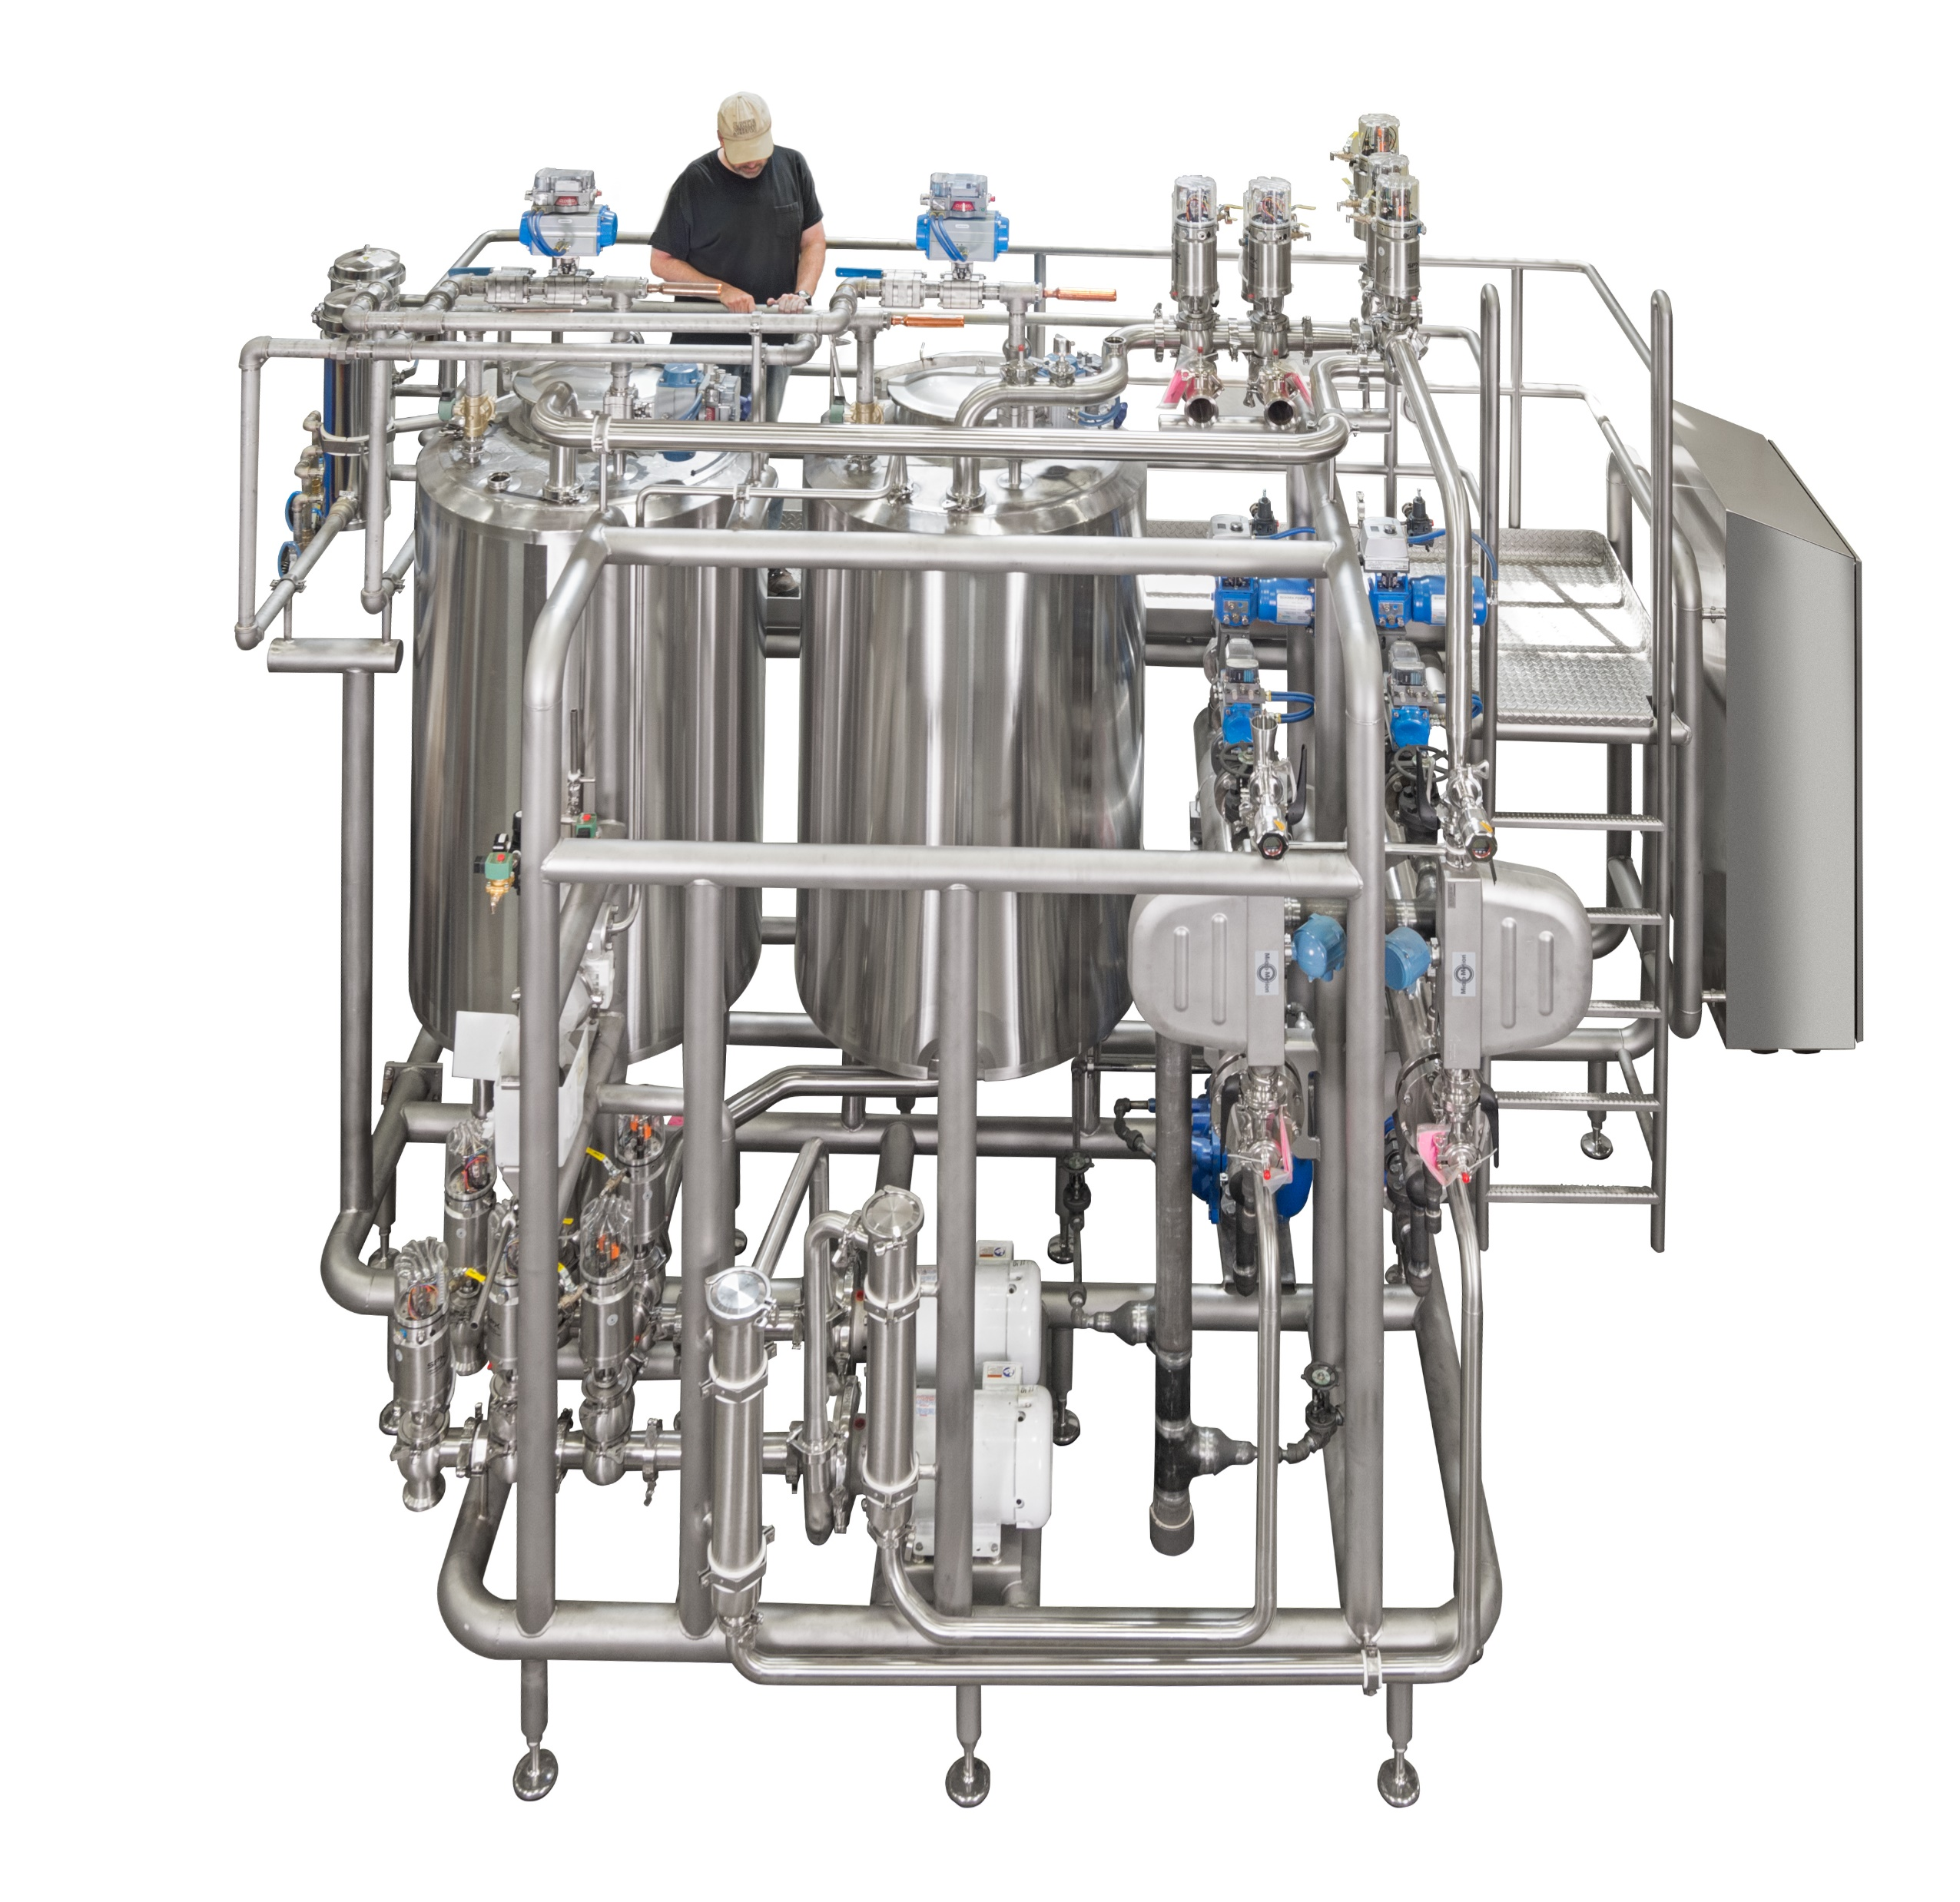
Products
Core market = Biopharma
Process Equipment and Systems
Mixers Blenders Agitators including Mag Drive Mixers
MixTanks – Plastic and Stainless Steel
MixTanks and Blending Systems – Integrated Skid Systems
Single Use Mixers and Systems
Custom Precision Stainless Steel Fabrication Services, Polishing, EP, Passivation
Mechanical seals including seal repairs for mixers and pumps
EXPERTISE IN THE DESIGN AND FABRICATION OF MIXERS, MIXTANKS, AND AUTOMATED SKIDDED BLENDING SYSTEMS WITH OPTIONAL CIP/SIP

Slide 4
Markets for Mixing and Blending
Pharma – Biotech, Pharmaceutical, Laboratories
Sanitary – Food, Beverage, Cosmetic, Nutraceutical
Industrial + Chemical – Battery Production, Complex Blends
We listen to your needs, and build mixers and blending systems to meet you exact desires.

Slide 5
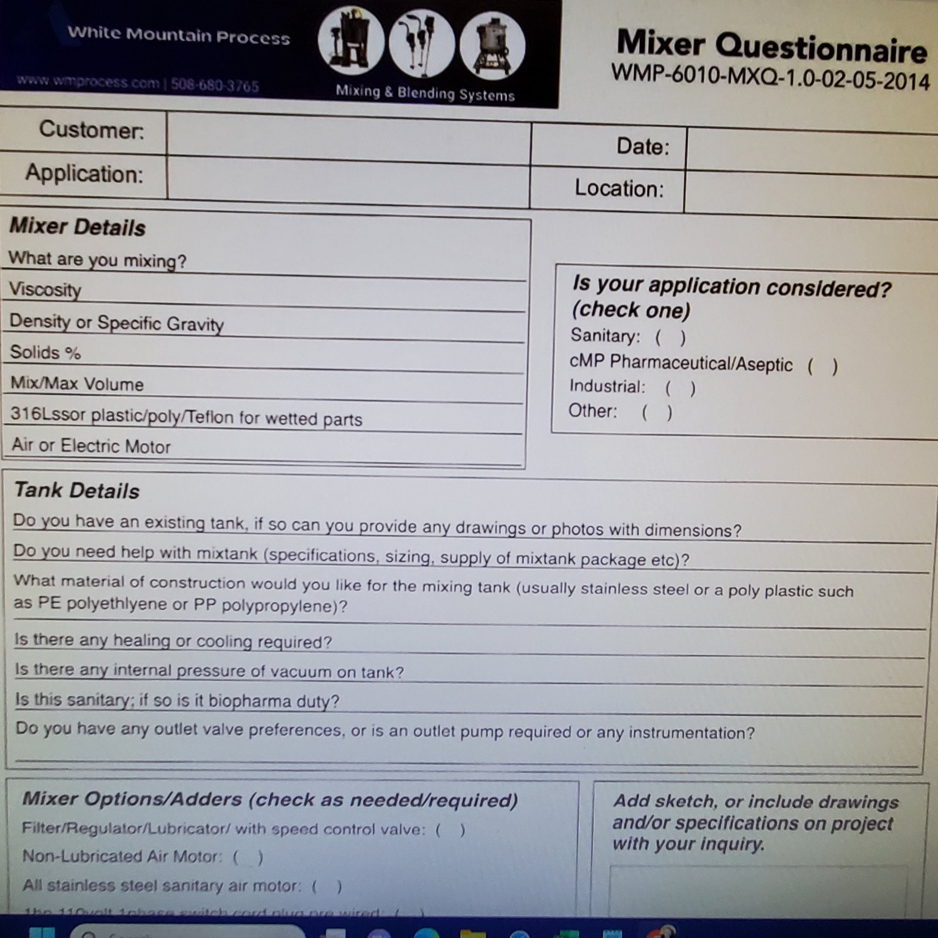
Mixer + Seal Data Sheets
Mixer - Volume, Viscosity, Density, % Solids+density, MOC-fit/finish, P+T, general process details (simple blending, emulsion, dispersion, temp uniformity, etc), Air/Pneumatic or Electric motor, and if Electricwe need voltage phase hertz, and advise if TEFC or XP, any any other specs/certs required
Mixtank - Bio, Food/Beverage, or Chemical duty, min/max volume to mix, valves-fittings-instruments-controls-automation
Seal - Pressure, Temp, Elastomers, Speed, for repair must send to our VT shop
WE CAN PROVIDE A SIMPLE LIST OF QUESTIONS (EMAIL FORMAT) FOR INQUIRIES ON MIXERS OR MIXTANKS
https://www.wmprocess.com/mixer-selection-and-specification/

Slide 6
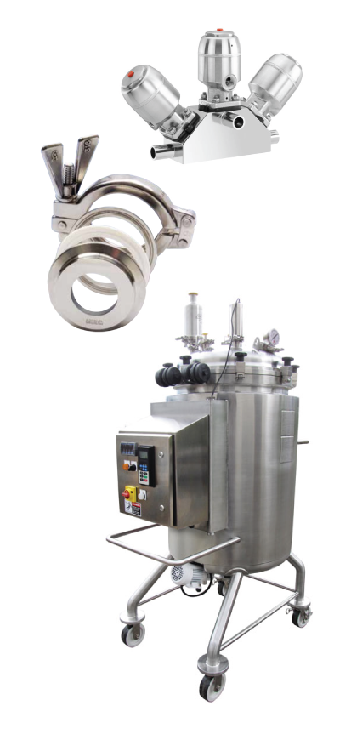
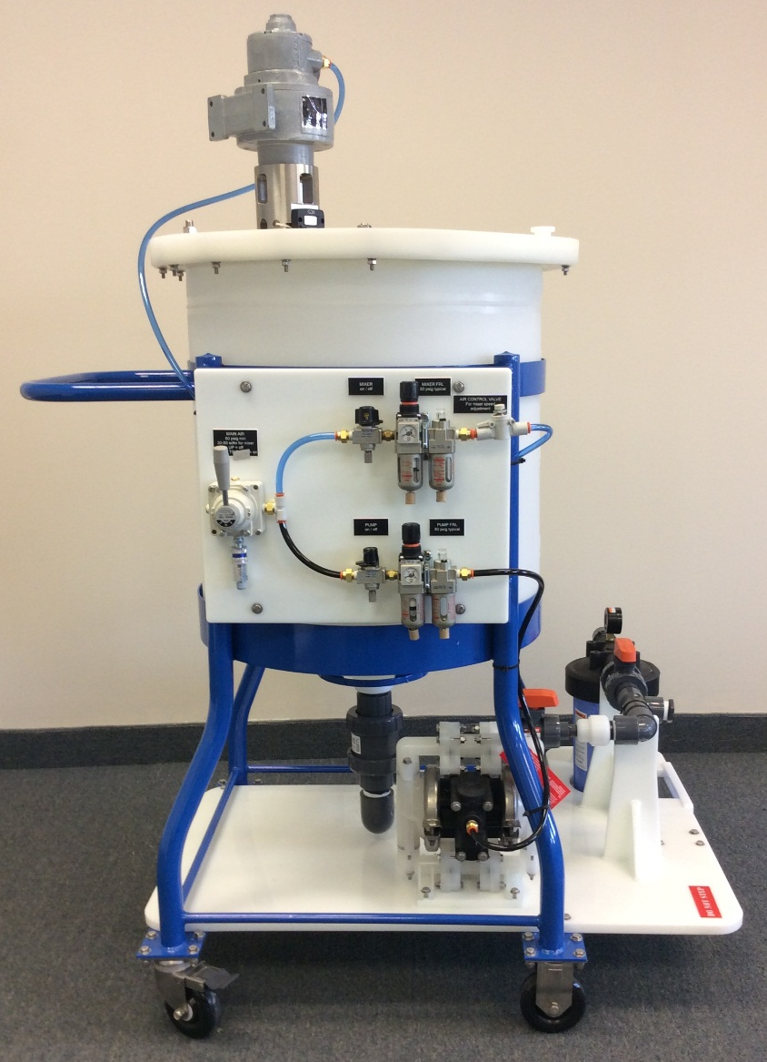
Key Mixing Applications
Sanitary Mixer / Single Use Mixer / Mixtank / Blending Systems Chromatography Resin Slurry / Buffer+Media Prep / Diagnostics

Slide 7
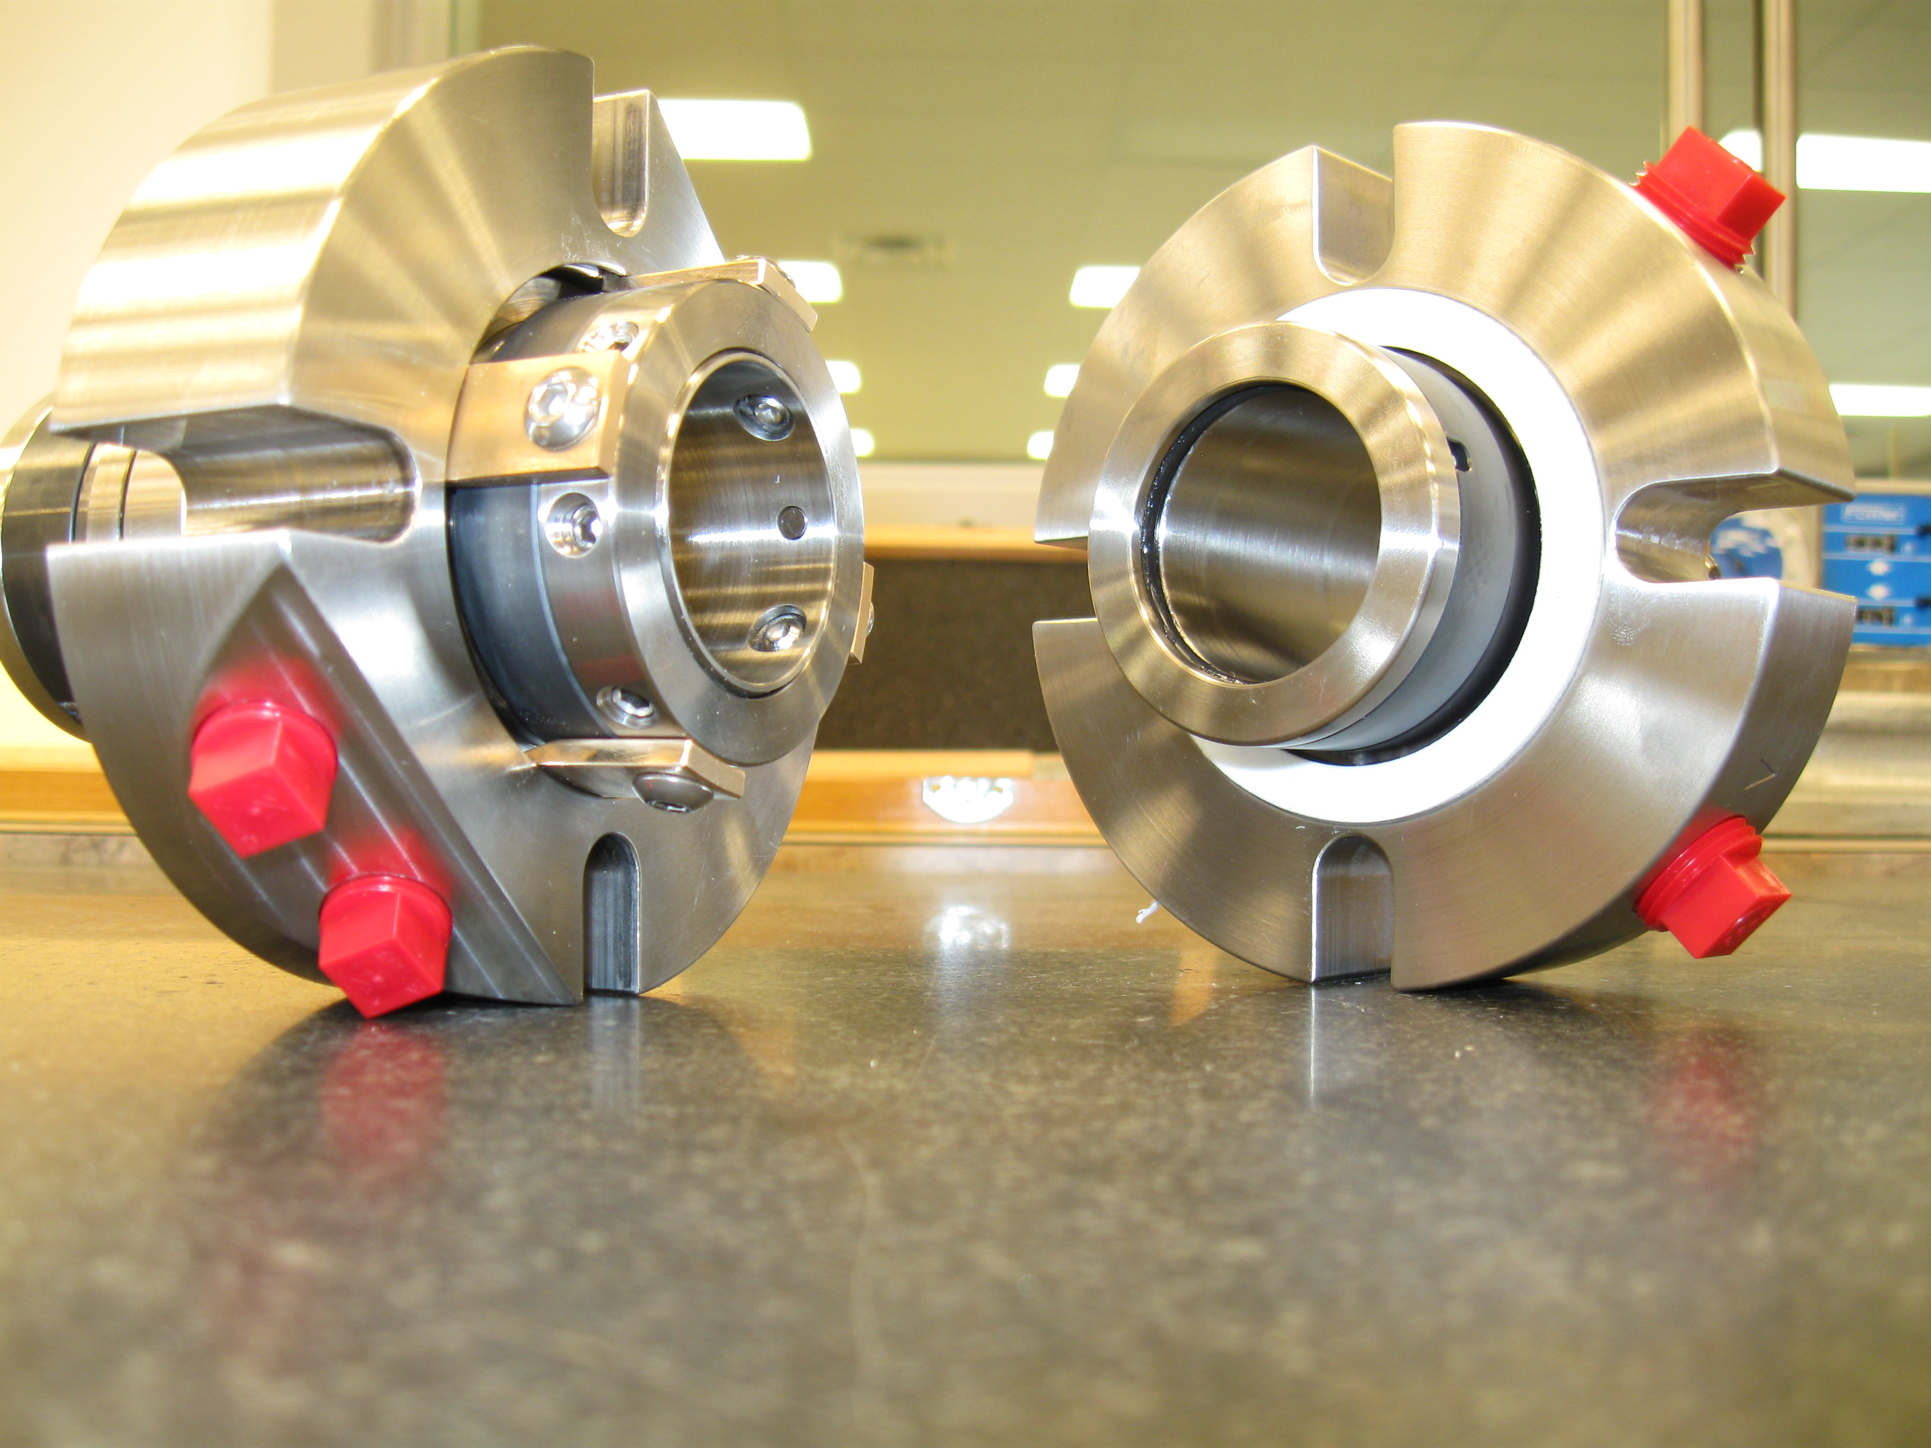
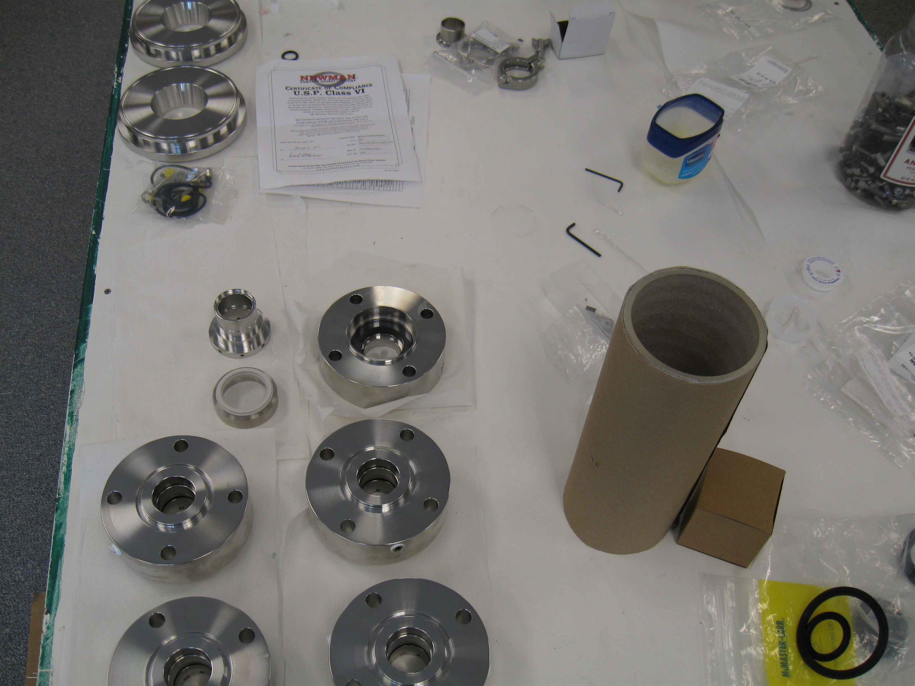
Mechanical Seals
New, Repairs and Troubleshooting
Single Mechanical Seals
Double Mechanical Seals
Seal Barrier Systems (liquid or nitrogen gas)
Seals for mixers, pumps, rotating equipment
We can repair/replace anyone’s mixer seal

Slide 8
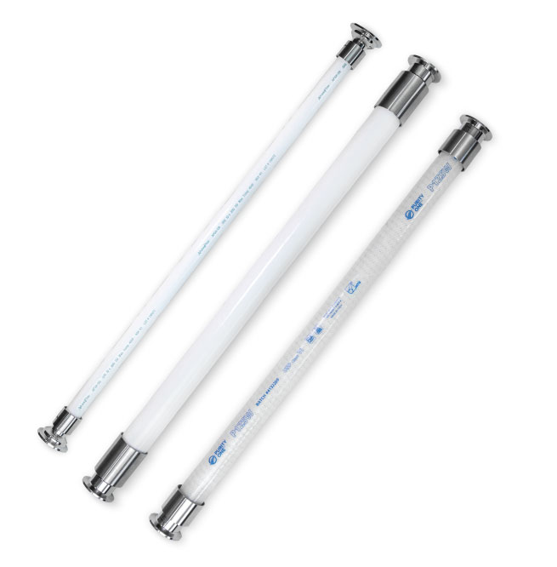
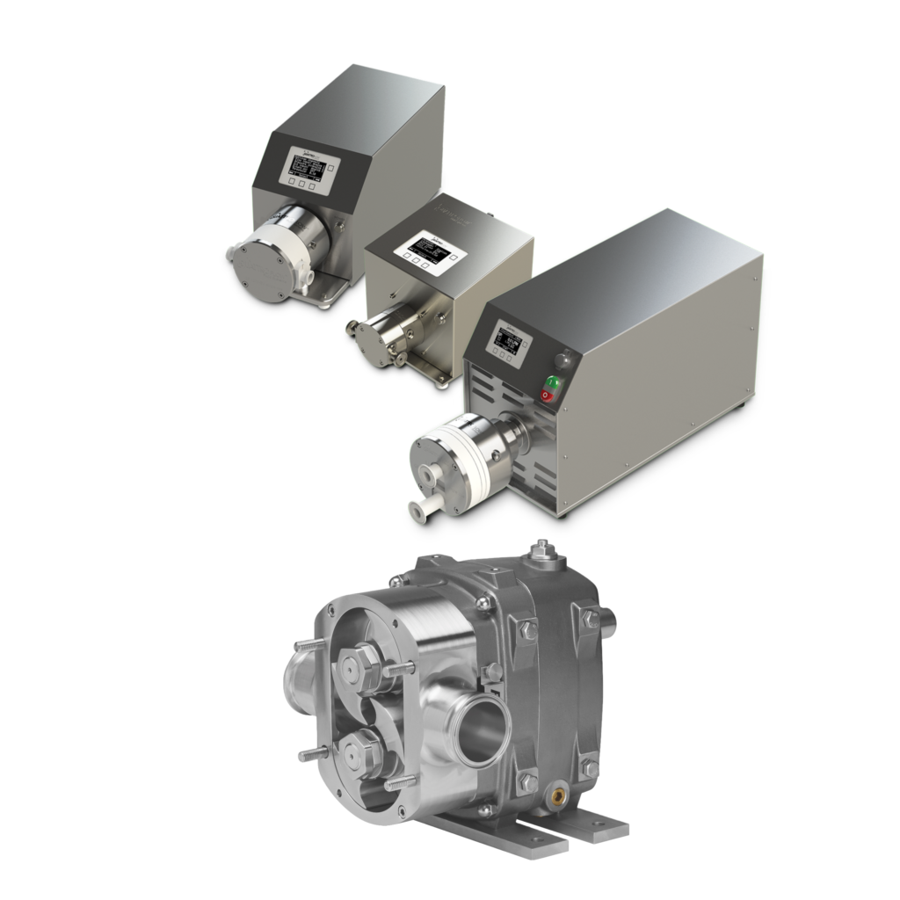
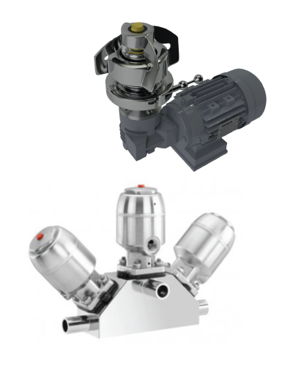
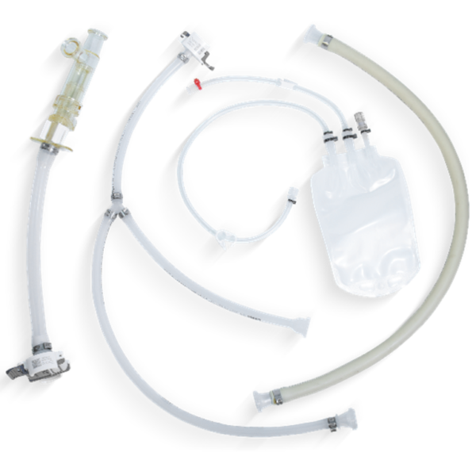
Distributed Products
More than just mixers
WHITE MOUNTAIN PROCESS CAN SUPPLY A VARIETY OF BIOPHARMA READY PRODUCTS THRU OUR CHANNEL PARTNERS, ALL PART OF THE LIFE SCIENCE SOLUTIONS GROUP

Slide 9
HOW CAN WE HELP YOU?
Call / Email / Text – Response and service is our claim to fame
Conference calls, Zoom/Teams, on-site visits, we want to be your mixer expert
Quotes usually issued within 48 hours on mixers, on mixing tanks can be a week depending on complexity, automated systems can be two weeks
Mike Matton
mike@wmprocess.com
(508) 680 - 3765
Joe Murray
joe@wmprocess.com
(508) 807 - 5377

